Slide 1
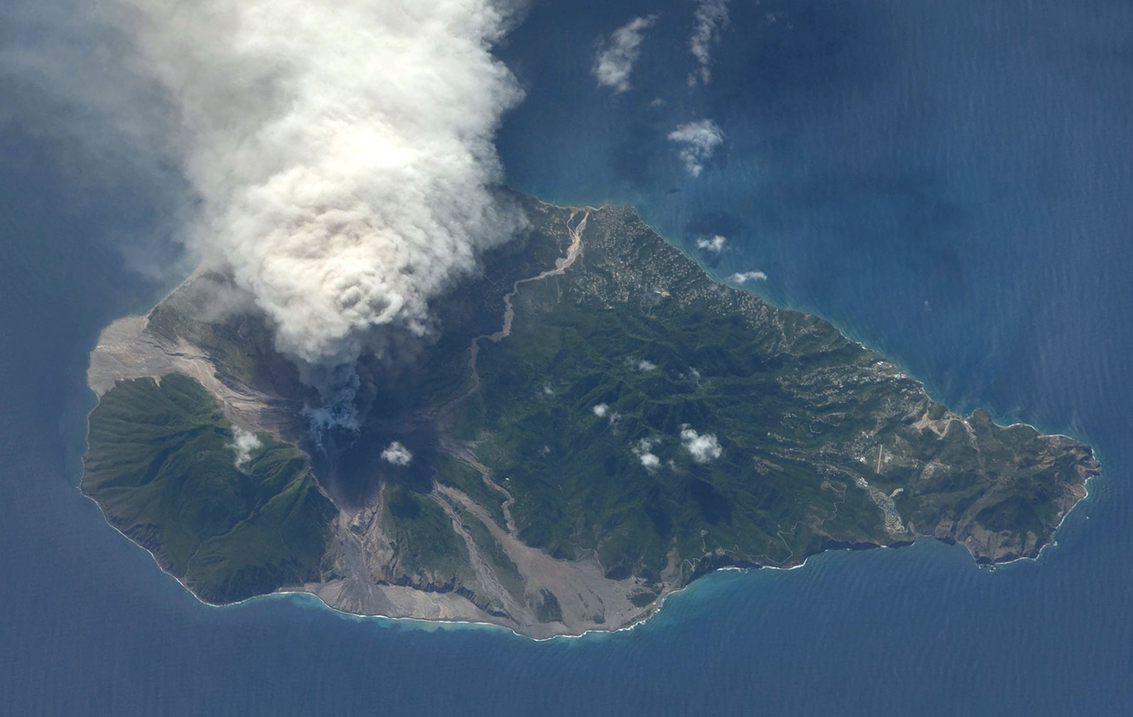
4. Montserrat: Living with a volcano

Slide 2
4. Montserrat: Living with a volcano
By the end of the end of the lesson you should be able to:
Explain why the Soufrière Hills volcano on Montserrat is erupting.
Know why a pyroclastic flow is so deadly.
Describe what happened to Plymouth, the capital and other settlements in the south.

Slide 3
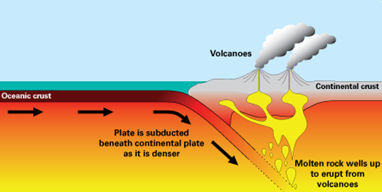
Why is the volcano erupting?
Caribbean plate
South American plate
The heavier North and South American plates have pushed under the lighter Caribbean plate.
Rock melted and pushed its way through the ocean floor forming underwater volcanoes.
The volcanoes grew, forming Montserrat and other Caribbean islands.
The plates are still moving, causing Montserrat’s volcano to erupt again.

Slide 4
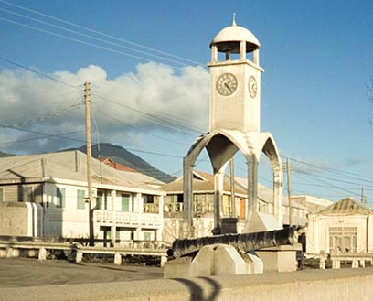
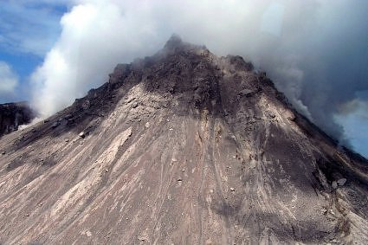
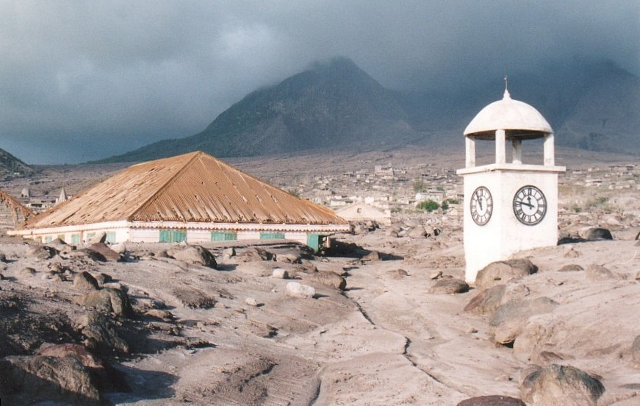
The Volcano Awakens
In January 1995 11000 people lived on Montserrat.
On July 18th 1995 the volcano began to awaken after nearly 400 years.
People abandoned the capital, Plymouth and by April 1996 the South of the island was empty.

Slide 5
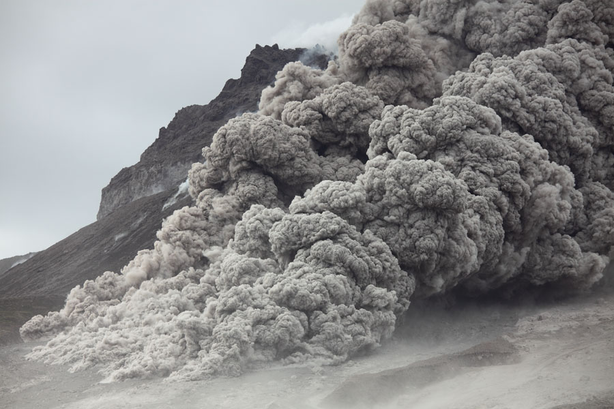
Pyroclastic Flows
Pyroclastic flows are a mixture of hot volcanic ash, boulders and gas.
Temperatures can be from 100 to 600 C
They travel at over 70 mph down the volcano
Composite volcanoes erupting very sticky lava can produce pyroclastic flows, when the dome becomes unstable.
Pyroclastic flows occur when large portions of the dome collapse and disintegrate.

Slide 6
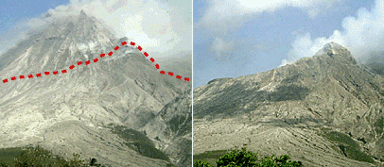
When Soufrière Hills volcano blew its’ top
On 25 June 1997 a massive eruption causes the dome of Soufrière volcano on Montserrat to collapse.
The resulting pyroclastic flow killed 19 people who had returned to their farms in the exclusion zone.

Slide 7
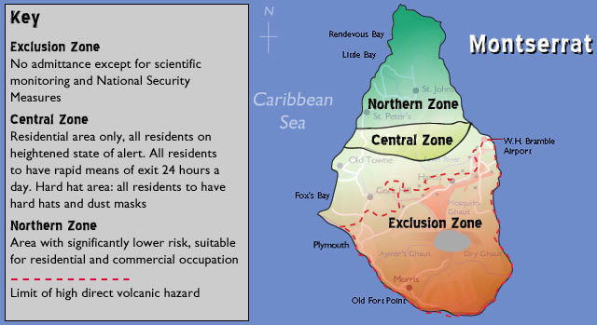

Slide 8
Show what you have learned
Explain in your own words why the volcano on Montserrat is erupting.
Look at the photos of Plymouth, the capital of Monserrat before and after the eruptions. Describe how it looks now.
How will the eruptions on Montserrat have affected:
a) farmers? b) hotel owners? c) taxi drivers?
4. Montserrat hopes to attract tourists again – as a volcano island! You are in charge of tourism.
Draw a sketch map of the island, showing the volcano, the new airport and the safe zone.
Mark in where you would put a new tourist hotel.
What activities will you lay on for tourists?
How will you make sure the tourists are safe?
What kind of souvenirs will you sell them?
Make up a slogan to attract tourists to the island.

